Slide 1
NextGen Enterprise Data Repository
“Zero Inline queries in NextGen Enterprise”
Vinay Ghagarwale, Sr Staff Engineer
Feb 10, 2019

Slide 2
Agenda
Introduction
Current Challenges
Inline query Statistics
Inline query Statistics PM
Technical Details
Architecture
Implementation Plan
Repository Pattern
Pros and Cons

Slide 3
Introduction
The intension of this project is to separate inline queries(Appx 5200+ in PM) which is binding with UI, BL and Data model to separate data repository.

Slide 4
Current Challenges
Current GCodbc Data layer has issues like memory leak
SQL injection problem ( App Sec)
Redundant SQL queries
Non Unit testable code
Database dependency

Slide 5
Inline SQL Query Statistics (Approx)

Slide 6
Inline Query Statistics in Practice Management(Approx)

Slide 7
Technical Details
Practice Management
UI
BL
SQL
Data Models
BL
SQL
BL
SQL

Slide 8
Technical Details
Data Repository
Practice Management
Manager
Repository 1
UI
BL
SQL
Repository 2
Data Models
BL
SQL
BL
SQL

Slide 9
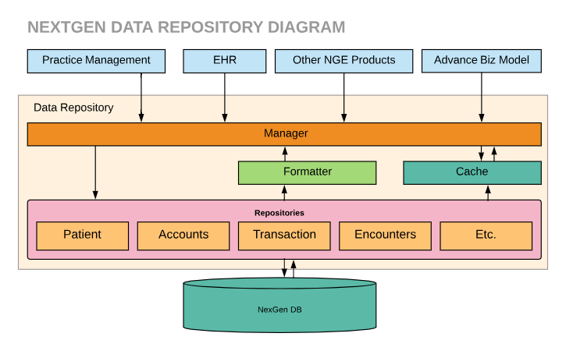
Architecture

Slide 10
Implementation plan
Develop a converter tool
All new sql must be implemented in here
Exisitng legacy SQL can move one by one
Formatter decide to construct return format like JSON, XML or List

Slide 11
Technology
C#
Repository Pattern
Structuremap for IOC
Nunit for Automated unit test
Nextgen.Data as a data layer

Slide 12
Repository Pattern
Separates the data access logic and maps it to the entities in the business logic. It works with the domain entities and performs data access logic. In the Repository pattern, the domain entities, the data access logic and the business logic talk to each other using interfaces. It hides the details of data access from the business logic. In other words, business logic can access the data object without having knowledge of the underlying data access architecture. For example, in the Repository pattern, business logic is not aware whether the application is using LINQ to SQL or ADO.NET Entity Model ORM. In the future, underlying data sources or architecture can be changed without affecting the business logic.
There are various advantages of the Repository Pattern including:
Business logic can be tested without need for an external source
Database access logic can be tested separately
No duplication of code
Caching strategy for the data source can be centralized
Domain driven development is easier
Centralizing the data access logic, so code maintainability is easier

Slide 13
Pros
SQL injection problem can be fixed ( APP Sec )
Remove redundant SQL queries ( DRY Principle )
Independent of NextGen Enterprise products
Unit-testable Data Access Layer
Parameterized caching technique
Current Gcodbc Data layer has issues like memory leak, can be replaced with Nextgen.data ( can think of ORMs ).
Can remove dependency on gcodbc and gcmisc dlls
Better SQL profiling
Centralizing the data access logic, so code maintainability is easier

Slide 14
Cons

Slide 15
Estimation ?
Best practices
Limit the number of sections to six, and keep wording brief.
The times in the right column are optional.
To add or subtract rows, use table tools.
Section 1 | 8 a.m.
Section 2 | 9:15 a.m.
Section 3 | 10 a.m.
Section 4 | 11 a.m.
Section 5 | 12 a.m.
Section 6 | 1 a.m.

Slide 16
Timeline
 | Q1 |  |  | Q2 |  |  | Q3 |  |  | Q4
 | Aug | Sept | Oct | Nov | Dec | Jan | Feb | Mar | Apr | May | Jun | Jul
Project 1
Project 2
Project 3
Project 4
Project 5

Slide 17
Icons
Use simple flat icons without applying additional styles.

Slide 18
Thank you.

